Slide 1
Lecture 7-2 Direct Mapped Caches Courtesy of A. Shrivastava (ASU) & Tack-Don Han (Yonsei)
Computer Architecture-Module3
Department of Computer Science
Kyoungwoo Lee

Slide 2
Agenda
Direct Mapped Caches
Thrashing Example (Homework & Discussion at Class)
Cache Operations

Slide 3
Direct Mapped Caches
Caches

Slide 4
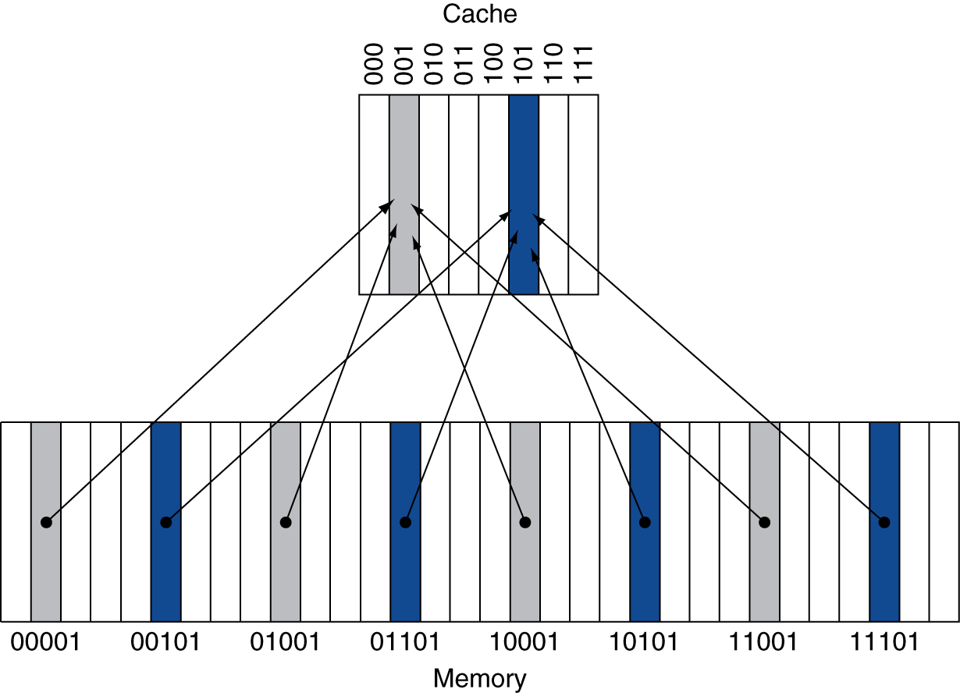
Direct-Mapped Caches: only one choice
Simplest Design
Each memory line has a unique cache location
32 memory lines & 8 cache lines
Memory lines with addresses of 00101, 01101, 10101, & 11101 have cache line with 101
Notes:
1 Byte = 8 bits
4 Bytes = 1 word = 16 Bits
16 Bytes = 4 Words
32 Bytes = 8 Words

Slide 5
Direct-Mapped Caches
Parameters
Line (aka block) size: B = 2^{b}
Number of bytes (B) in each line
Number of Sets: S = 2^{s}
Number of lines cache can hold
Total Cache Size: B x S = 2^{b+s}
Physical Address
Address used to reference main memory
n bits to reference N = 2^{n} total bytes
Partition into fields
Offset: Lower b bits indicate which byte within line
Set: Next s bits indicate how to locate line within cache
Tag: Identifies this line when in cache
n-bit Physical Address
t
s
b
tag
set index
offset
Notes:
1 Byte = 8 bits
4 Bytes = 1 word = 16 Bits
16 Bytes = 4 Words
32 Bytes = 8 Words

Slide 6
Indexing into Direct-Mapped Cache
Use set index bits to select cache set/block
Set 0:
Tag
Valid
0
1
• • •
B–1
Set 1:
Tag
Valid
0
1
• • •
B–1
•
•
•
Set S–1:
Tag
Valid
0
1
• • •
B–1
t
s
b
tag
set index
offset
Physical Address

Slide 7
Direct-Mapped Cache Tag Matching
Identifying Line
Must have tag match high order bits of address
Must have Valid = 1
= 1?
Selected Set:
= ?
Tag
Valid
0
1
• • •
B–1
Lower bits of address select byte or word within cache line
t
s
b
tag
set index
offset
Physical Address

Slide 8
Direct Mapped Cache
0000xx
0001xx
0010xx
0011xx
0100xx
0101xx
0110xx
0111xx
1000xx
1001xx
1010xx
1011xx
1100xx
1101xx
1110xx
1111xx
Main Memory
Cache
Two low order bits define the byte in the word (32b words)
Index
Valid
Tag
Data
00
01
10
Q2: How do we find it?
Use next 2 low order memory address bits – the index – to determine which cache block (i.e., modulo the number of blocks in the cache)
11
Q1: Is it there?
Compare the cache tag to the high order 2 memory address bits to tell if the memory block is in the cache
(block address) modulo (# of blocks in the cache)
Notes:
For lecture
Valid bit indicates whether an entry contains valid information – if the bit is not set, there cannot be a match for this block

Slide 9
Direct Mapped Cache
0 0 0 0 0 0
0 0 0 0 0 1
0 0 0 0 1 0
0 0 0 0 1 1
0000xx
0001xx
0010xx
0011xx
0100xx
0101xx
0110xx
0111xx
1000xx
1001xx
1010xx
1011xx
1100xx
1101xx
1110xx
1111xx
Cache
Valid
Tag
Data
Index
00
01
tag
index
offset
10
11
0 0 0 0 0 0
0 0 0 0 0 1
0 0 0 0 1 0
0 0 0 0 1 1
tag
index
offset
Notes:
For lecture
Valid bit indicates whether an entry contains valid information – if the bit is not set, there cannot be a match for this block

Slide 10
Cache Example
Decimal Address | Binary Address | Hit or Miss | Cache Block
22 | 10110 |  | 110
26 | 11010 |  | 010
22 | 10110 |  | 110
26 | 11010 |  | 010
16 | 10000 |  | 000
3 | 00011 |  | 011
16 | 10000 |  | 000
18 | 10010 |  | 010
16 | 10000 |  | 000
Hit or Miss
Miss
Miss
Hit
Hit
Miss
Miss
Hit
Miss
Hit
8-blocks, 1 word/block, direct mapped
Initial state
Index | V | Tag | Data
000 | N
001 | N
010 | N
011 | N
100 | N
101 | N
110 | N
111 | N

Slide 11
Cache Example
Word addr | Binary addr | Hit/miss | Cache block
22 | 10 110 | Miss | 110
Index | V | Tag | Data
000 | N
001 | N
010 | N
011 | N
100 | N
101 | N
110 | Y | 10 | Mem[10110]
111 | N

Slide 12
Cache Example
Word addr | Binary addr | Hit/miss | Cache block
26 | 11 010 | Miss | 010
Index | V | Tag | Data
000 | N
001 | N
010 | Y | 11 | Mem[11010]
011 | N
100 | N
101 | N
110 | Y | 10 | Mem[10110]
111 | N

Slide 13
Cache Example
Word addr | Binary addr | Hit/miss | Cache block
22 | 10 110 | Hit | 110
26 | 11 010 | Hit | 010
Index | V | Tag | Data
000 | N
001 | N
010 | Y | 11 | Mem[11010]
011 | N
100 | N
101 | N
110 | Y | 10 | Mem[10110]
111 | N

Slide 14
Cache Example
Word addr | Binary addr | Hit/miss | Cache block
16 | 10 000 | Miss | 000
3 | 00 011 | Miss | 011
16 | 10 000 | Hit | 000
Index | V | Tag | Data
000 | Y | 10 | Mem[10000]
001 | N
010 | Y | 11 | Mem[11010]
011 | Y | 00 | Mem[00011]
100 | N
101 | N
110 | Y | 10 | Mem[10110]
111 | N

Slide 15
Cache Example
Word addr | Binary addr | Hit/miss | Cache block
18 | 10 010 | Miss | 010
Index | V | Tag | Data
000 | Y | 10 | Mem[10000]
001 | N
010 | Y | 10 | Mem[10010]
011 | Y | 00 | Mem[00011]
100 | N
101 | N
110 | Y | 10 | Mem[10110]
111 | N

Slide 16
Direct Mapped Cache
Cache Block (line): the cache data that has in its own cache tag
A 1Kbyte direct mapped cache with 1 word blocks for MIPS
1 word = 4 Bytes
31
10
9
2
1
0
Cache Tag
Cache Index
Byte Select
Ex: 0x50
Ex: 0x01
Ex: 0x00
Valid Bit
Byte 3
:
Byte 1
Byte 0
0
0x50
Byte 3
Byte 1
Byte 0
1
:
:
:
:
:
255
Cache Tag
Cache Data

Slide 17
Direct Mapped Cache
Cache Block (line): the cache data that has in its own cache tag
In order to take advantage of Spatial Locality: increase the block size
A 1Kbyte direct mapped cache with 32 byte blocks
31
10
9
5
4
0
Cache Tag
Cache Index
Byte Select
Ex: 0x50
Ex: 0x01
Ex: 0x00
Valid Bit
Byte 31
:
Byte 1
Byte 0
0
0x50
Byte 31
Byte 1
Byte 0
1
:
:
:
:
:
31
Cache Tag
Cache Data

Slide 18
Multiword Block Direct Mapped Cache
Four words/block, cache size = 1K words = 4K Bytes
Data
(word)
Hit
31 30 . . . 13 12 11 . . . 4 3 2 1 0
Byte offset
Tag
20
8
Block offset
Index
Data
Valid
Tag
Index
0
1
2
.
.
.
253
254
255
20
32
Notes:
to take advantage for spatial locality want a cache block that is larger than word word in size.

Slide 19
Bits in a Cache
How many total bits are required for a direct-mapped cache with 16 KB of data and 4 word blocks, assuming a 32-bit address?
16 KB is 4096 (2¹²) words
With a block size of 4 words, 1024 (2¹⁰) blocks
Each block has 4x32 or 128 bits of data plus a tag, which is 32 – 10 – 2 – 2 bits, plus a valid bit
Thus, total cache size is
2¹⁰ x (4x32 + (32 – 10 – 2 – 2) + 1) = 2¹⁰ x 147 = 147 K bits = 18.4 KB

Slide 20
Actual Size of Bits in a Cache (General)
The total number of bits needed for a cache is a function of the cache size and the address size
n-bit Physical Address
32-bit address (n = 32)
A direct-mapped cache
The cache size is 2^{s} blocks, s bits are used for the index
The block size is 2^{b-2} words (2^{b} bytes), (b-2) bits are used for the word within the block
Then, the size of the tag field is 32 – (s + b) = t
The total number of bits in a direct-mapped cache is 2^{s} x (block size + tag size + valid field size)
2^{s} x (2^{b-2} x n + t + 1) = actual size in bits
t
s
b
tag
set index
offset

Slide 21
Mapping an Address to a Multiword Cache Block
Consider a cache with 64 blocks and 16 bytes/block. To what block number does byte address 1200 map?
Block Address is Byte Address/Bytes per Block containing all addresses b/w (byte address/bytes per block)*bytes per block and (byte address/bytes per block)*bytes per block + (bytes per block – 1)
Block address = ⎣1200/16⎦ = 75
Block is given by (Block Address) modulo (Number of Blocks in the Cache)
Block number = 75 modulo 64 = 11
31
10
9
4
3
0
Tag
Index
Offset
22 bits
6 bits
4 bits

Slide 22
Properties of Direct Mapped Caches
Strength
Minimal control hardware overhead
Simple design
(Relatively) easy to make fast
Weakness
Vulnerable to thrashing
Two heavily used lines have the same cache index
Repeatedly evict one to make room for other
Cache Line

Slide 23
Thrashing Example
Caches

Slide 24
Vector Product Example
float dot_prod(float x[1024], y[1024])
{
float sum = 0.0;
int i;
for (i = 0; i < 1024; i++)
sum += x[i]*y[i];
return sum;
}
Machine
DEC Station 5000
MIPS Processor with 64KB direct-mapped cache, 16 B line size
Performance
Good case: 24 cycles / iteration
Bad case: 66 cycles / iteration

Slide 25
Thrashing Example
x[0]
y[0]
x[1]
Cache
Line
y[1]
Cache
Line
x[2]
y[2]
x[3]
y[3]
•
•
•
•
•
•
•
•
•
Cache
Line
•
•
•
Cache
Line
x[1020]
y[1020]
x[1021]
Cache
Line
y[1021]
Cache
Line
x[1022]
y[1022]
x[1023]
y[1023]
Access one element from each array per iteration

Slide 26
Thrashing Example: Good Case
x[0]
y[0]
The TWO arrays are mapped to different blocks in the cache
Cache
Line
x[1]
y[1]
x[2]
y[2]
x[3]
y[3]
Access Sequence
Read x[0]
x[0], x[1], x[2], x[3] loaded
Read y[0]
y[0], y[1], y[2], y[3] loaded
Read x[1]
Hit
Read y[1]
Hit
• • •
2 misses / 8 reads
Analysis
x[i] and y[i] map to different cache lines
Miss rate = 25%
Two memory accesses / iteration
On every 4th iteration have two misses
Timing
10 cycle loop time
28 cycles / cache miss
Average time / iteration = 24
10 + 0.25 * 2 * 28

Slide 27
Thrashing Example: Bad Case
x[0]
y[0]
The TWO arrays are mapped to SAME block in the cache
Cache
Line
x[1]
y[1]
x[2]
y[2]
x[3]
y[3]
Access Pattern
Read x[0]
x[0], x[1], x[2], x[3] loaded
Read y[0]
y[0], y[1], y[2], y[3] loaded
Read x[1]
x[0], x[1], x[2], x[3] loaded
Read y[1]
y[0], y[1], y[2], y[3] loaded
• • •
8 misses / 8 reads
Analysis
x[i] and y[i] map to same cache lines
Miss rate = 100%
Two memory accesses / iteration
On every iteration have two misses
Timing
10 cycle loop time
28 cycles / cache miss
Average time / iteration = 66
10 + 1.0 * 2 * 28

Slide 28
Cache Operation
Caches

Slide 29
The Cache Architecture
MAIN MEMORY
Memory address
Read/Write Data
Program
Decoder
Processor
Memory Bus
Cache Blocks
Notes:
1) If the cache had a total of 16 blocks, with 16 bytes each,
- What is the size of the memory address ?
- How will you access byte x in Block y ?
Ans: 5bits for the 16blocks,
5bits for the 16bytes in each block
Total memory address size = 8bits
When you double the memory size, which bit differs in the modulo of cache size ?
- This is the tag id that is used to identify if the memory block in the cache -- > valid status
Now, modulo (# cache blocks) is the mapping from main memory to the cache.
To identify which cache block contains the required data, if valid bit =1, use the next set of bits to identify the set associated with the memory address.
3)

Slide 30
Cache Operation
address from CPU
select block(s),
read tag and data
read
read or
write?
hit
miss
read or
write?
write
tag comparison
write
read
select & return
data to CPU
write to the
block
replace a
valid block
no
available
block?
read from
memory
later
no
yes
write to
memory
immediate
yes
write-around
write-allocate
write-back
write-through
read from memory, write to cache, return data to CPU

Slide 31
Decreasing Miss Penalty with Multilevel Caches
Add a second level cache:
often primary cache is on the same chip as the processor
use SRAMs to add another cache above primary memory (DRAM)
miss penalty goes down if data is in 2nd level cache
Example:
CPI of 1.0 on a 5 GHz machine with a 5% miss rate, 100ns DRAM access
Adding 2nd level cache with 5ns access time decreases miss rate to 0.5%
Using multilevel caches:
try and optimize the hit time on the 1st level cache
try and optimize the miss rate on the 2nd level cache

Slide 32
Quiz / Assignments
How do Direct Mapped Caches work with Tag, Valid, Index, and Offset?
What and how much is the cache miss penalty?
What is the main difference between Write-back and Write-through policies?

Slide 33
Exercise 5.2
Caches are important to providing a high-performance memory hierarchy to processors. Below is a list of 32-bit memory address references, given as word addresses.
3, 180, 43, 2, 191, 88, 190, 14, 191, 44, 186, 253
For each of these references, identify the binary address, the tag, and the index given a direct-mapped cache with 16 one-word blocks. Also list if each reference is a hit or a miss, assuming the cache is initially empty.
For each of these references, identify the binary address, the tag, and the index given a direct-mapped cache with two word blocks and a total size of 8 blocks. Also list if each reference is a hit or a miss, assuming the cache is initially empty.

Slide 34
Exercise 5.3
For a direct-mapped cache design with a 32-bit address, the following bits of the address are used to access the cache.
What is the cache block size (in words)?
How many entries does the cache have?
What is the ratio between total bits required for such a cache implementation over the data storage bits?
Tag | Index | Offset
31 – 10 | 9 – 5 | 4 – 0

Slide 35
Summary
Direct Mapped Caches – Simplest Cache Design
Cache Operations: Write-back vs. Writh-through
Next: Set Associate Caches

